Slide 1
Motive Support Portal
Access request information – Portal Walk Through
03/10/2024
Jo Gys

Slide 2
Introduction
Motive Support Portal : https://motive.zendesk.com
The Motive Support Portal purpose :
(maintenance) Ticket creation and follow up for customers that have a direct contract with Motive. This includes managed services tasks for the Motive hosted services team as well. Note : for Nokia contracts the Nokia portal https://customer.nokia.com/support/s/ is can still be used but we encourage making a switch over to Motive’s Zendesk already.
Access to Motive product documentation.
Access to Product Lifecycle and other types of alerts.
Access to Knowledge Articles once published.
A possibility to receive Motive SW download links after creating a ticket

Slide 3
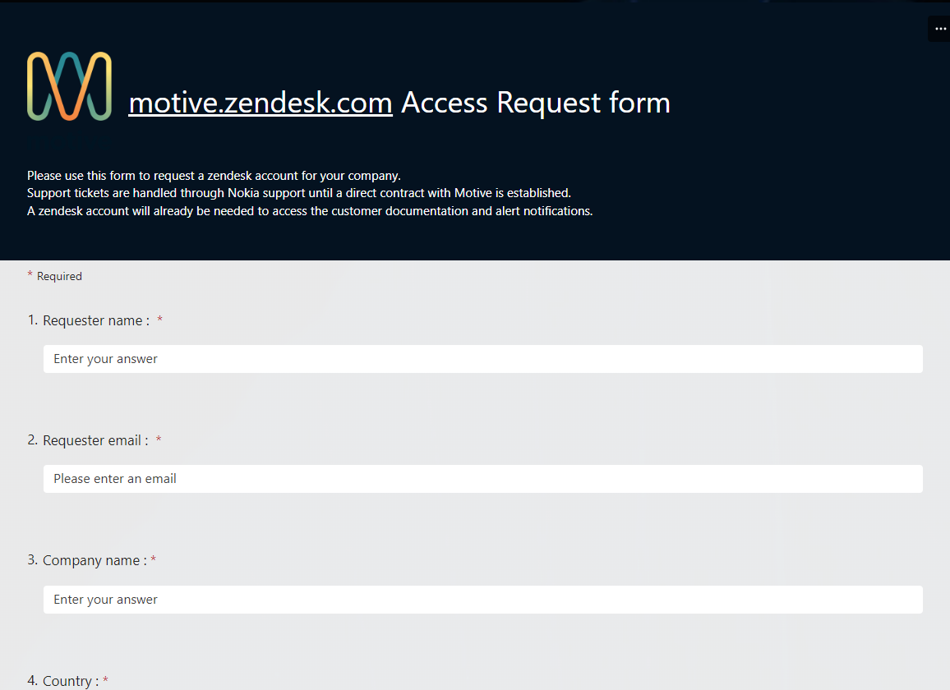
How to request access?
Open link and fill in the form motive.zendesk.com Access Request form
Submit the form

Slide 4
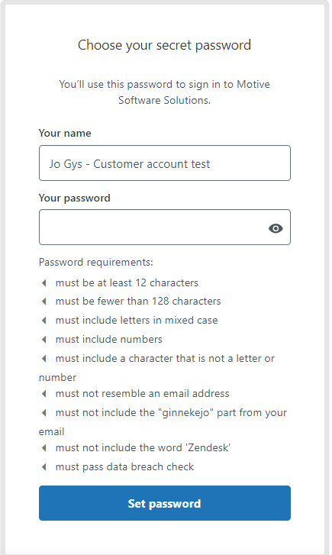
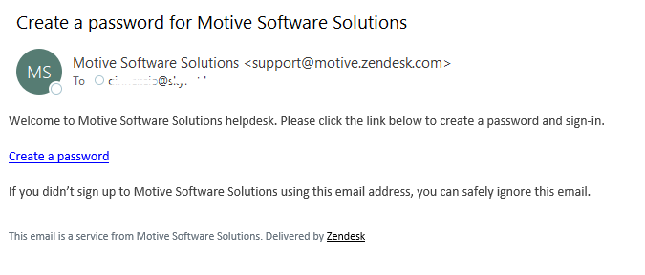
First Access
Registration email
Once the Motive welcome centre processed the request,
a Motive Zendesk registration email will be received.
Follow the link and create a password.

Slide 5
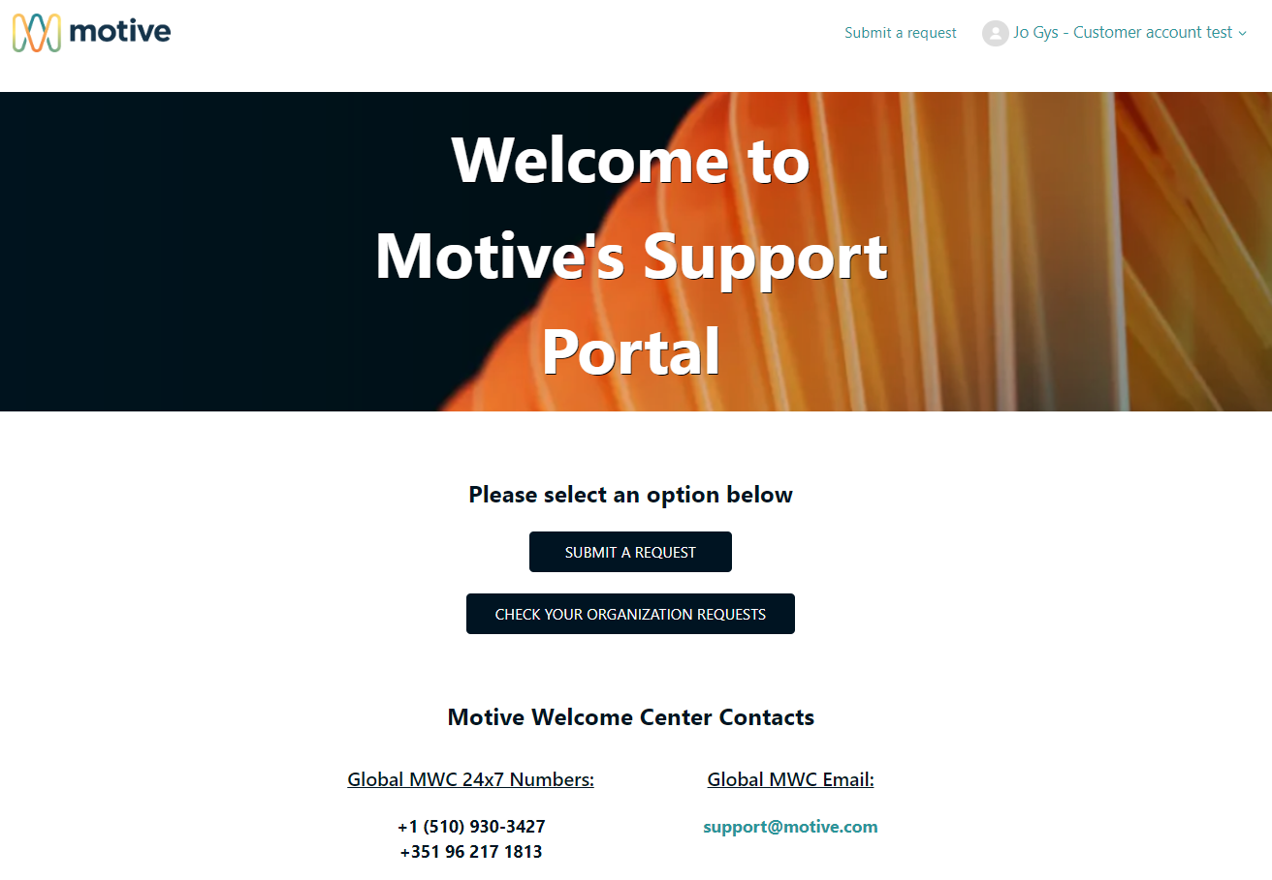
First login
Once the password is created and logged in, the portal will be opened

Slide 6
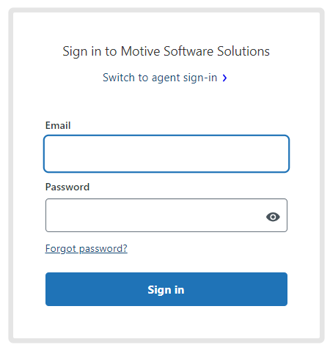
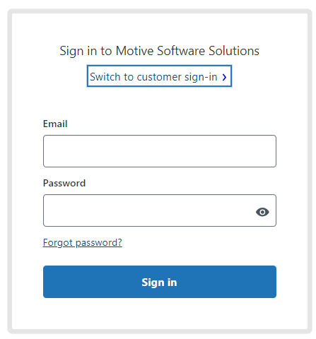
Future Logins
Ok
Access the portal through https://motive.zendesk.com Important :
If the login page shows “Switch to customer sign-in” then click that link first until it displays “Switch to agent sign-in”
Not ok

Slide 7
What to do in case of issues with registration?
Contact the Motive Welcome Centre and explain your case
The Motive Welcome Centre is available 24x7

Slide 8
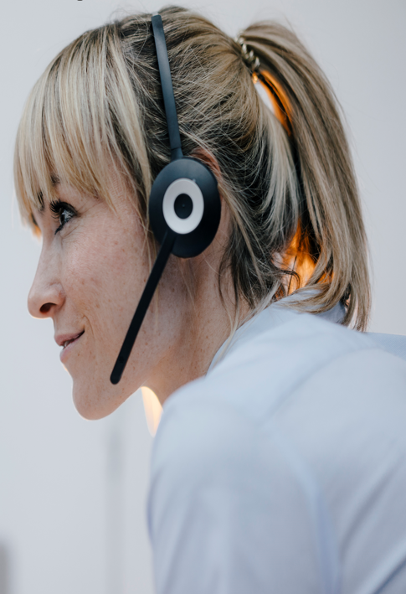
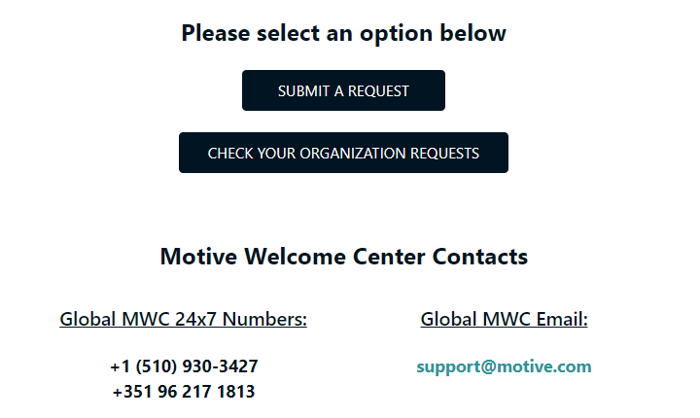
Portal highlights
Top section : support requests
Note : outages must be raised by phone only

Slide 9
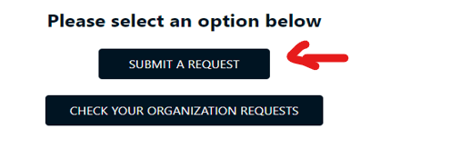
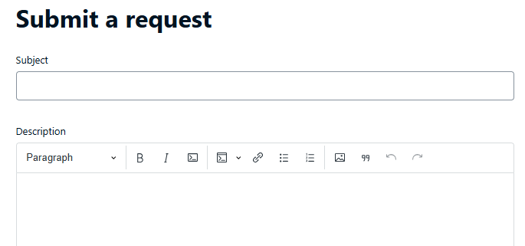
Portal highlights
Top section : support requests through the Portal
Fill in the complete form and press “submit”
Subject : a 1-line problem description
Description : full description of the request, including what was already tried.
Priority : read as “severity”
Product : the product that support is needed for
Type : indicate if it’s an incident/question/task/problem
Environment : production or lab
Support type : indicate if it’s technical support or a managed services type contract.
Sw release : the software version
Motive hosted deployment : only ticket this box when the solution is hosted by Motive hosted services
Attachments : any relevant logs / screenshots etc. that help with the investigation

Slide 10
Portal highlights
Top section : support requests through the Portal
Once the ticket is created a confirmation email is sent back
Ticket updates are received through the portal and email
Tickets can be responded through the portal or by responding to the email

Slide 11
Portal highlights
Middle section : announcements and knowledge
Note : Knowledge is “work in progress”

Slide 12
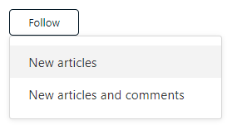
Portal highlights
Middle section : announcements and knowledge
Subscribe to announcements by pressing the “follow” button in the sections of interest By example :

Slide 13
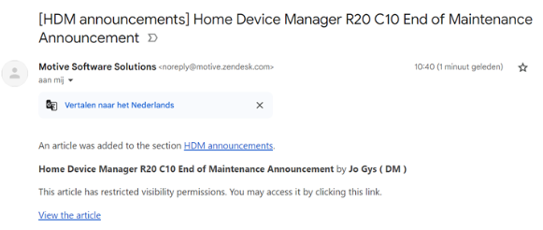
Portal highlights
Middle section : announcements and knowledge
Once following, an email will be received when new content is submitted
THANK YOU FOR FOLLOWING !!! Note : “Following” 1 specific article does only provide a notification for comment updates, and not for article updates !

Slide 14
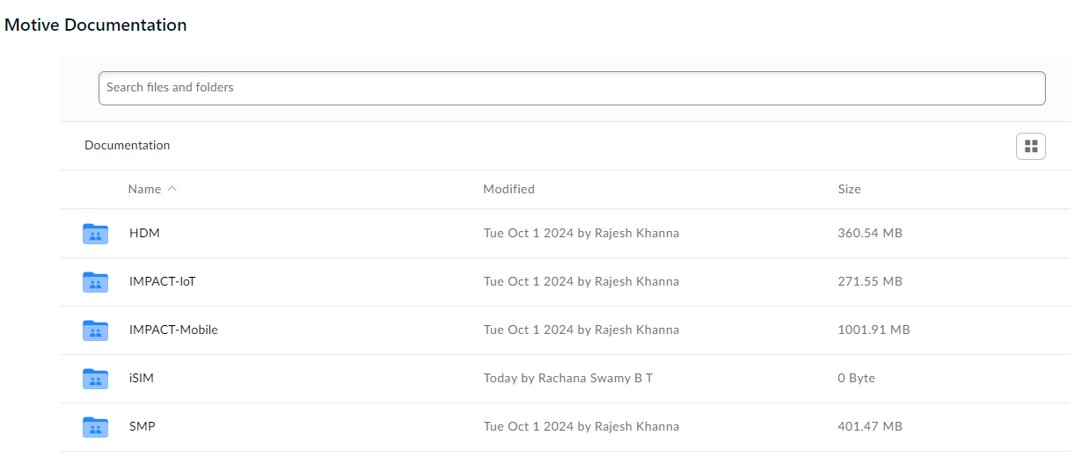
Portal highlights
Bottom section : customer documentation

Slide 15
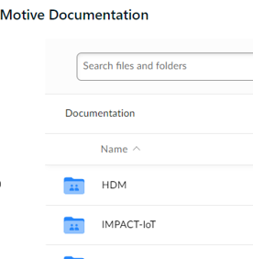
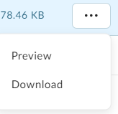
Portal highlights
Bottom section : customer documentation
Here it’s possible to drill down and to download or open the document of interest
Note : only 1 document can be opened or loaded at the same time

Slide 16
Motive support
support@motive.com

